Slide 1

AWS IAM

Slide 2
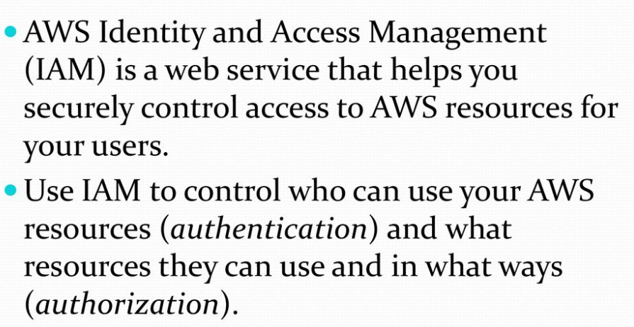
AWS IAM Introduction

Slide 3
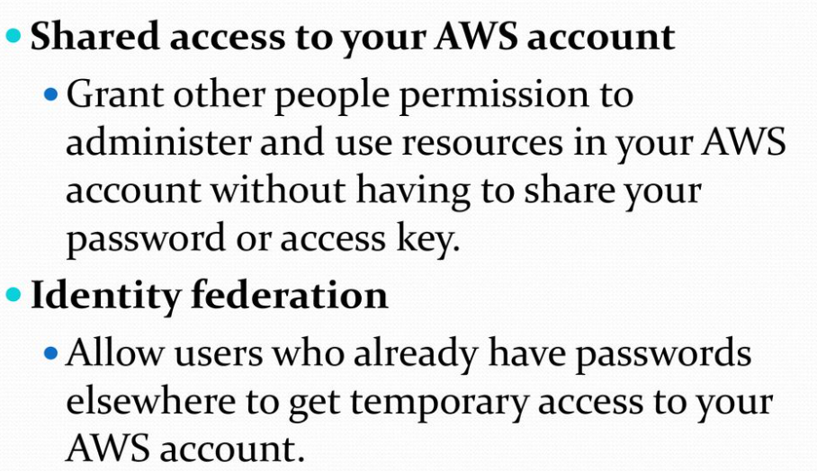
IAM Features

Slide 4
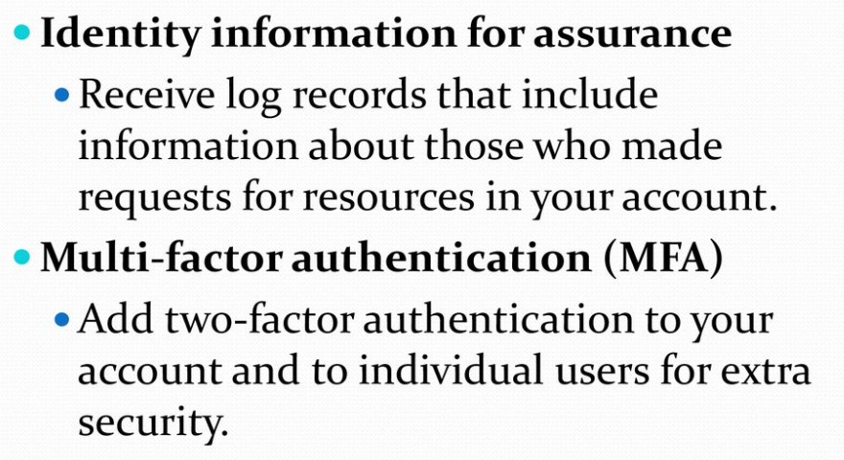
IAM Features

Slide 5
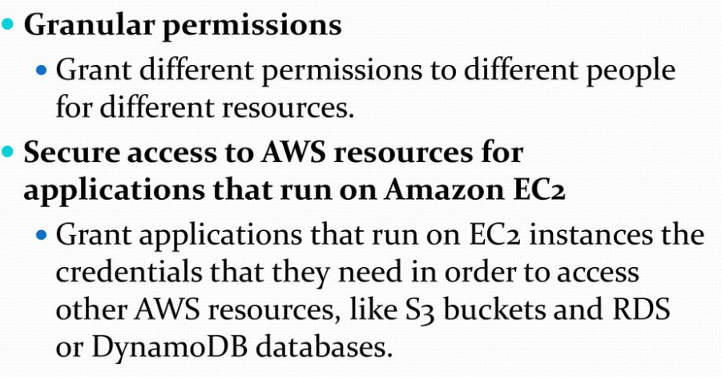
IAM Features

Slide 6
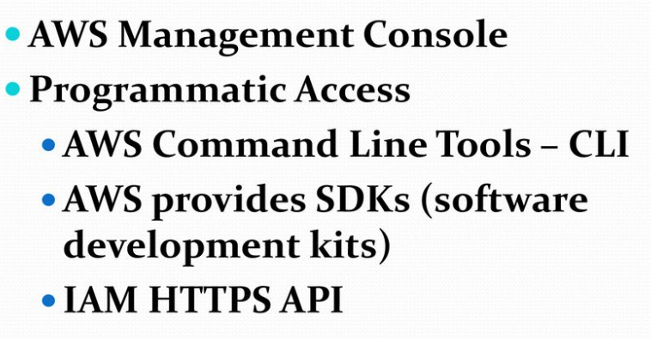
Accessing IAM

Slide 7
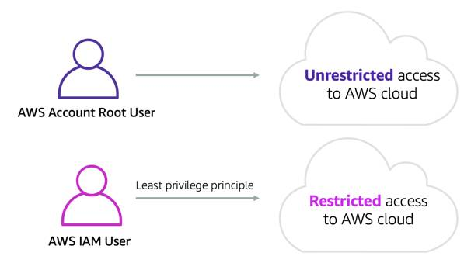
IAM User
An IAM user is a resource in IAM that has associated credentials and permissions. An IAM user can represent a person or an application that uses its credentials to make AWS requests.

Slide 8
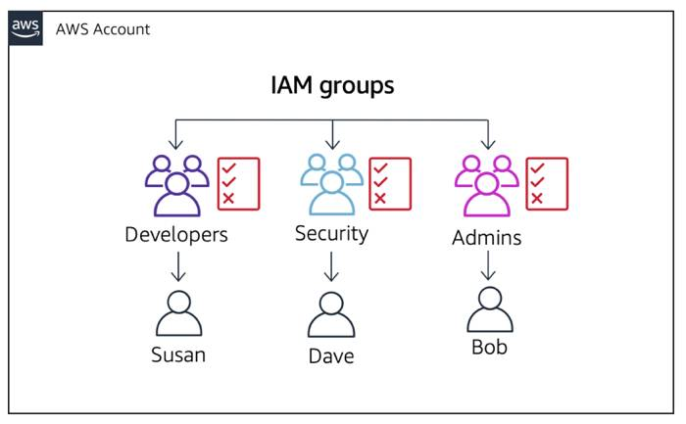
IAM Groups
An IAM user group is a collection of IAM users. User groups let you specify permissions for multiple users, which can make it easier to manage the permissions for those users.

Slide 9
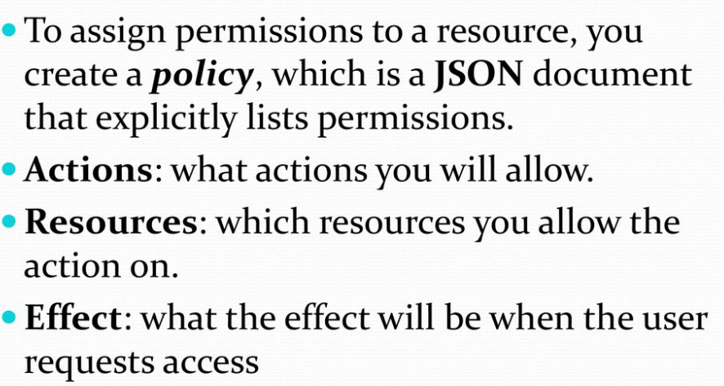
IAM Policies

Slide 10
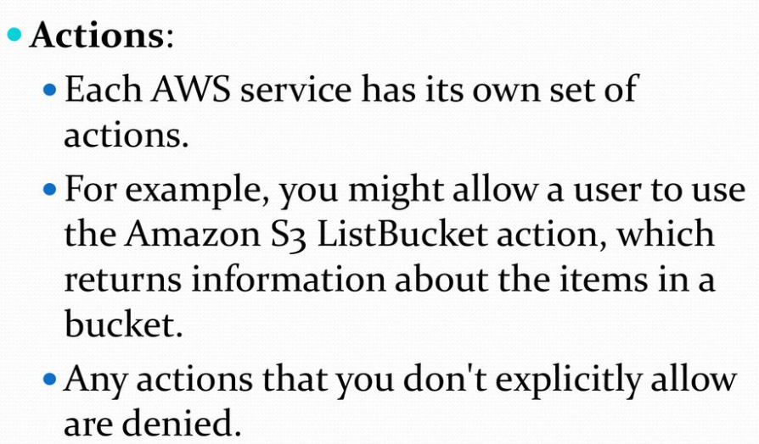
IAM Policies

Slide 11
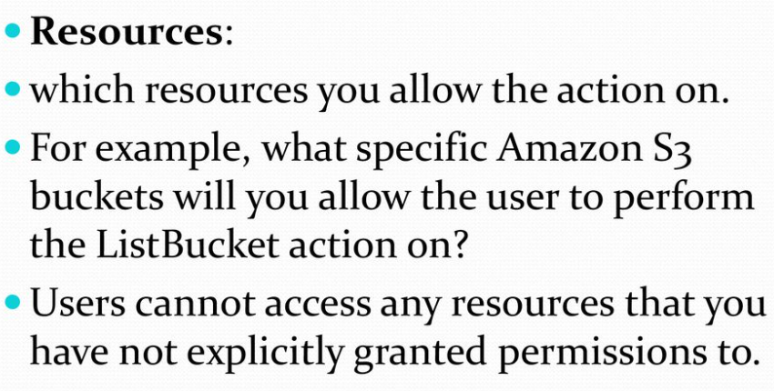
IAM Policies

Slide 12
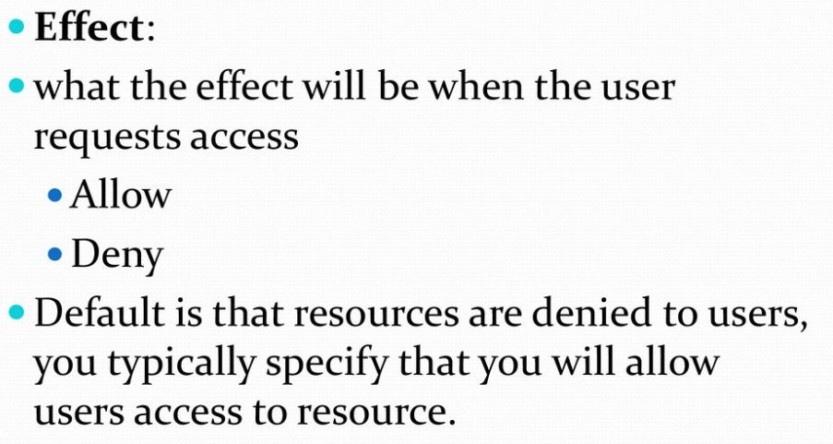
IAM Policies

Slide 13
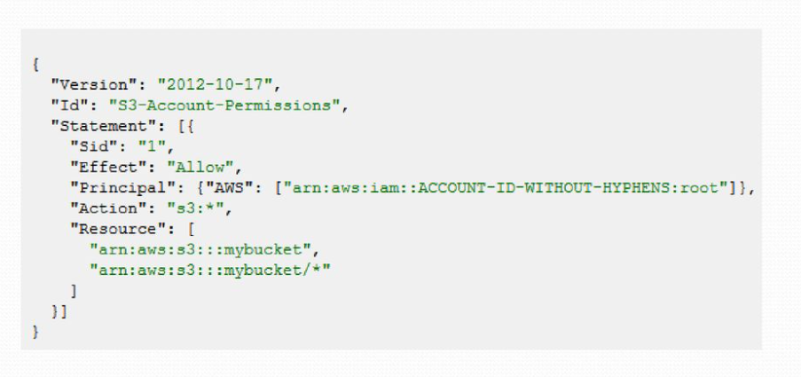
IAM Policies

Slide 14
Hands on

